Slide 1
1

Slide 2
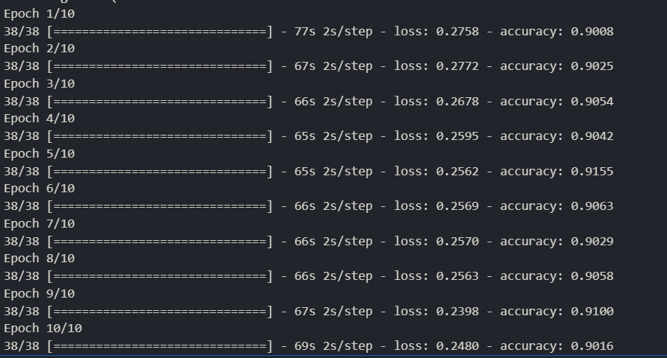
Notes:
Try 4/17 → 10 epochs (densenet201)
the preprocessing doesn’t work well
imbalance in Categories
Not found acc val / loss val using

Slide 3
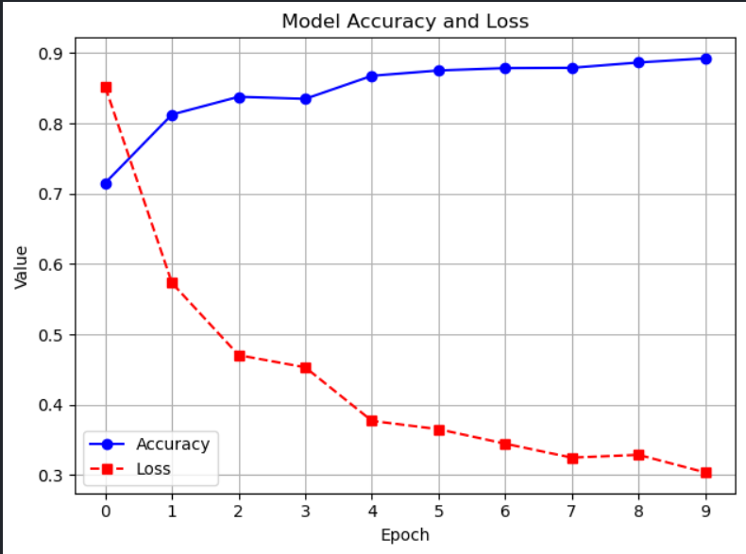

Slide 4
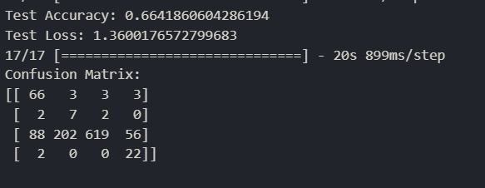

Slide 5
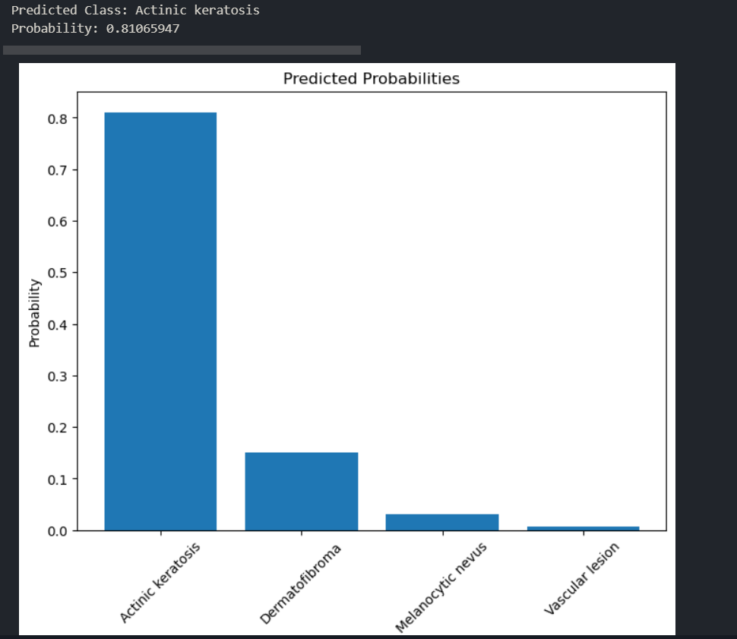

Slide 6
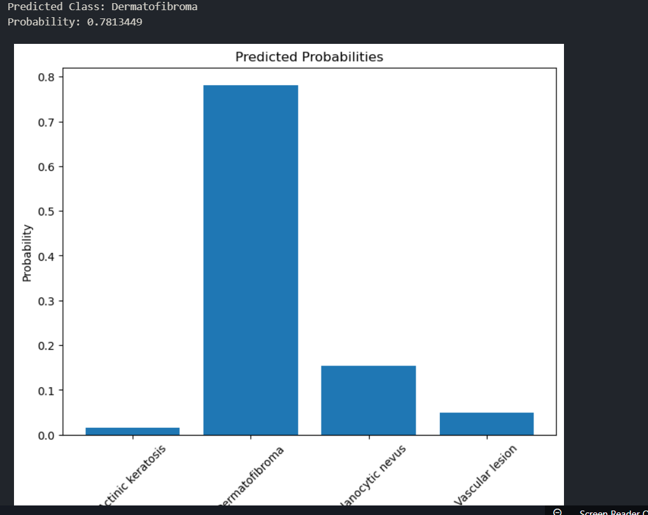

Slide 7
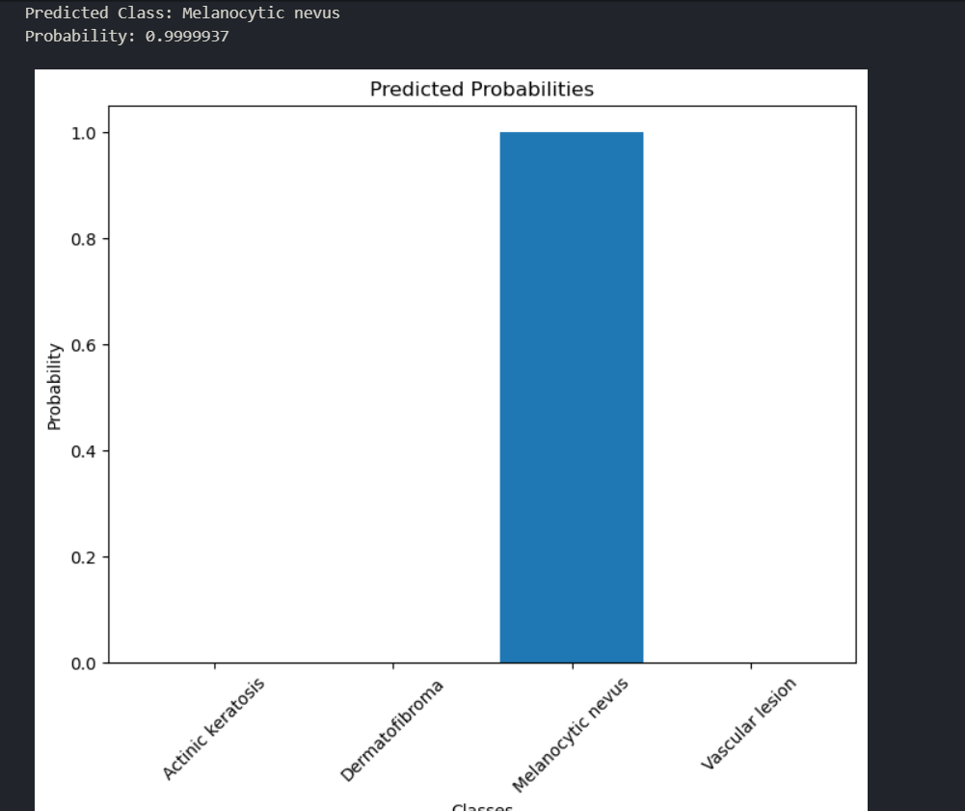

Slide 8
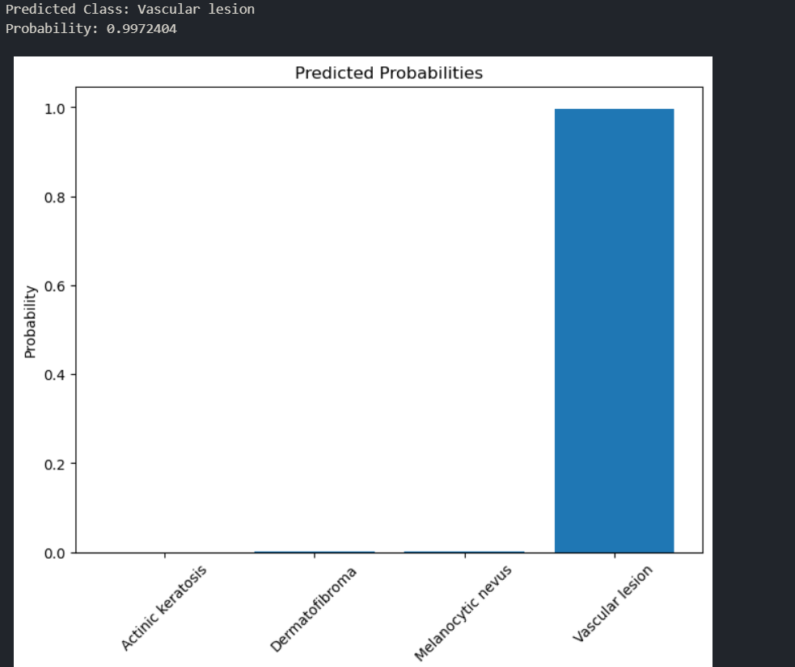

Slide 9
2

Slide 10
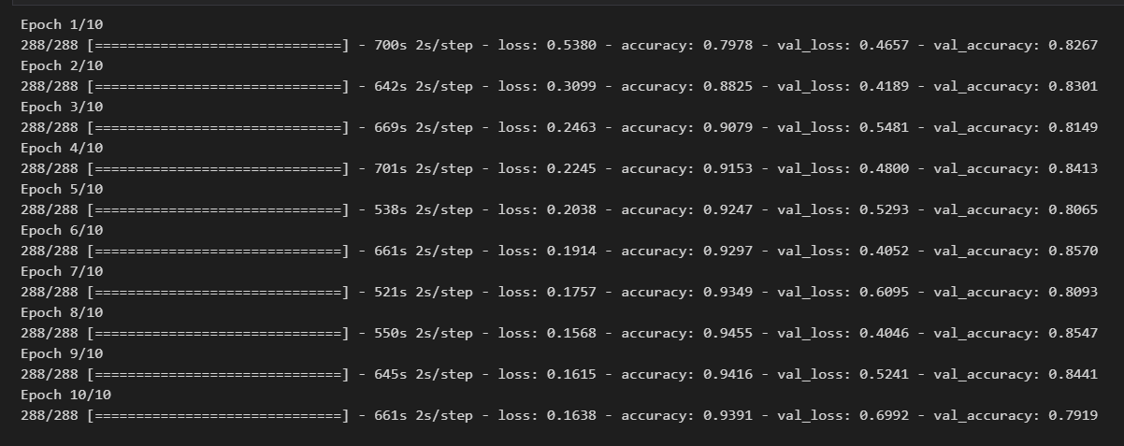
Notes:
Try 4/18 → 10 epochs (densenet201)
Edit (increasedata) with duplicated samples extranl
After remove (shear_range=0.2,zoom_range=0.2,brightness_range=[0.7, 1.3])
Add part of use validation after training every epoch same augmented operation on val

Slide 11
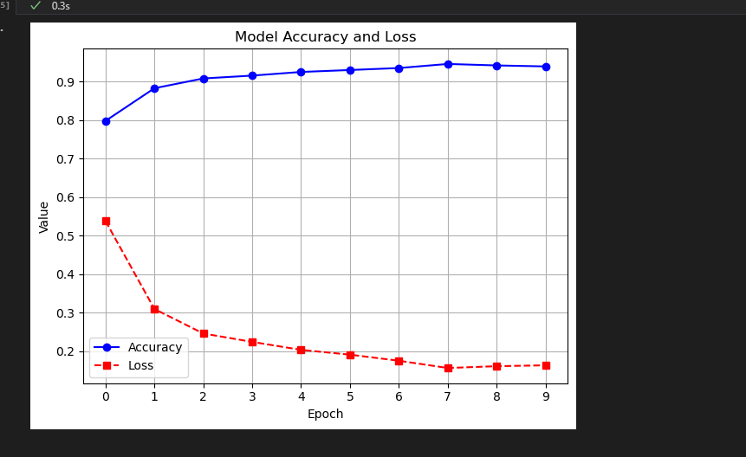

Slide 12
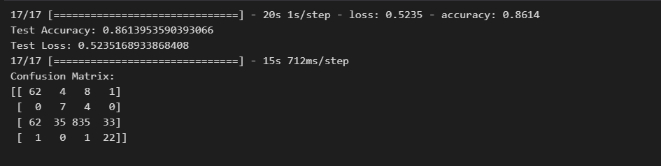

Slide 13
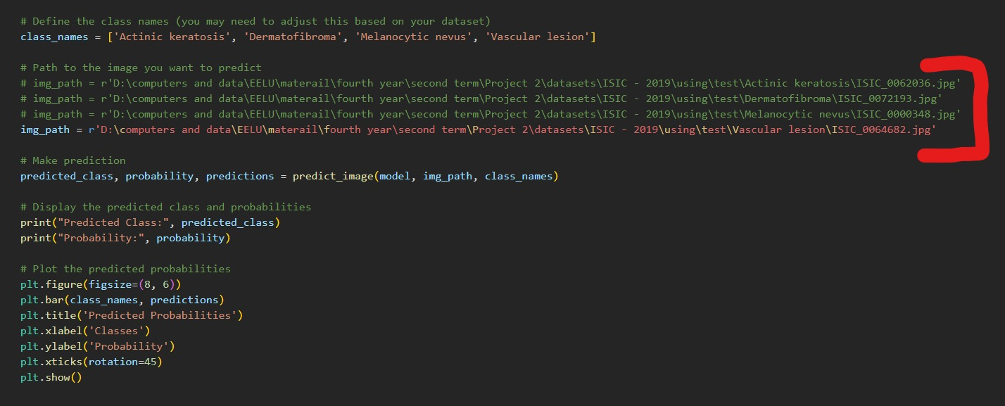

Slide 14
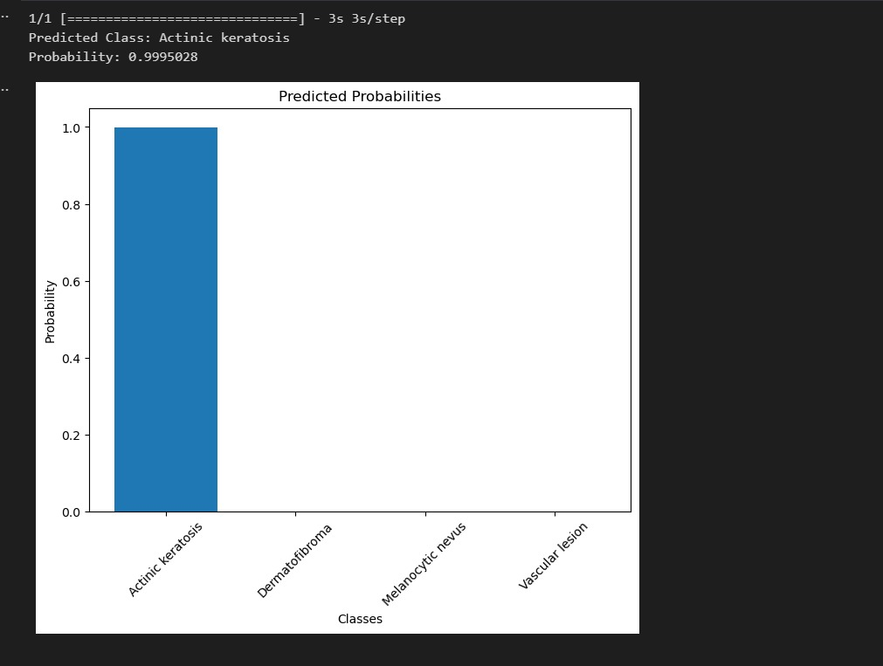

Slide 15
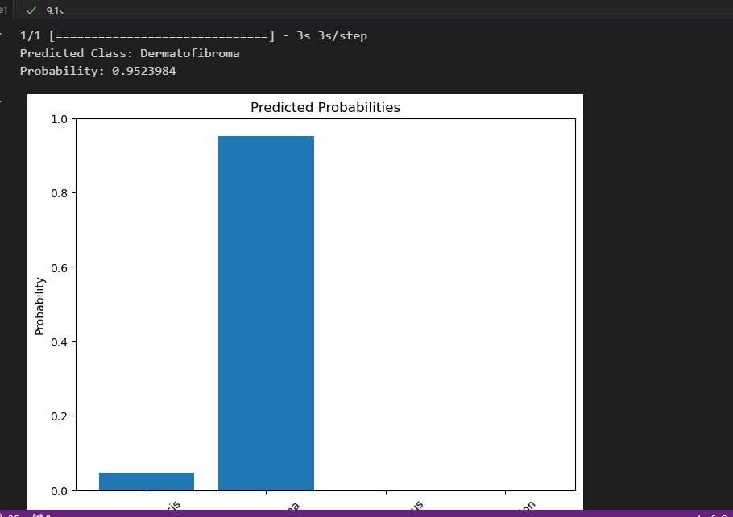

Slide 16
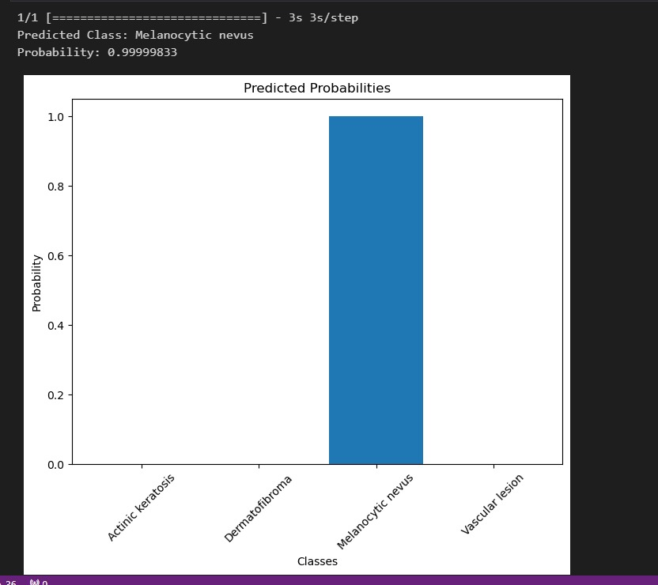

Slide 17
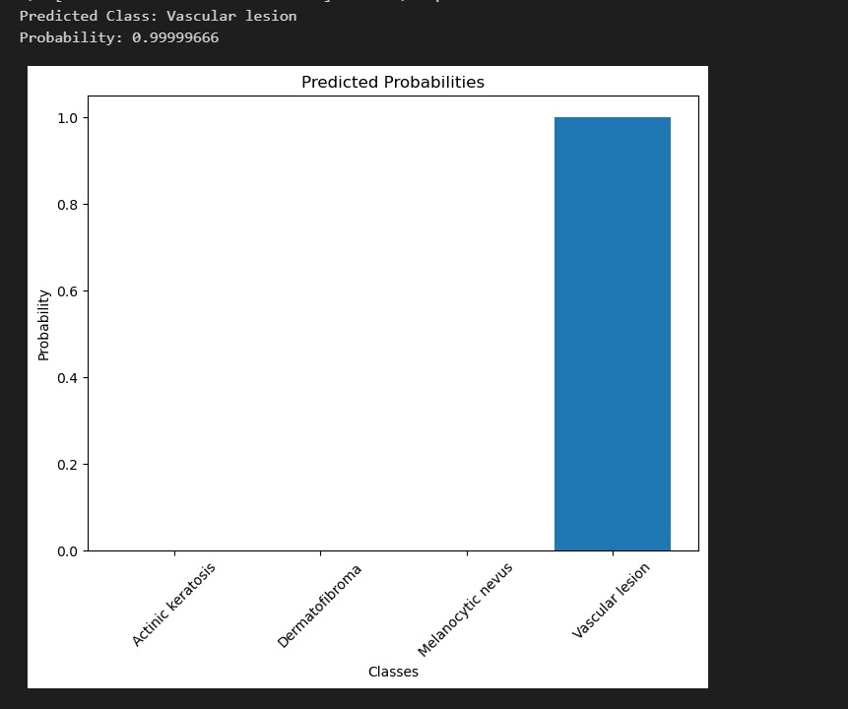

Slide 18
3

Slide 19
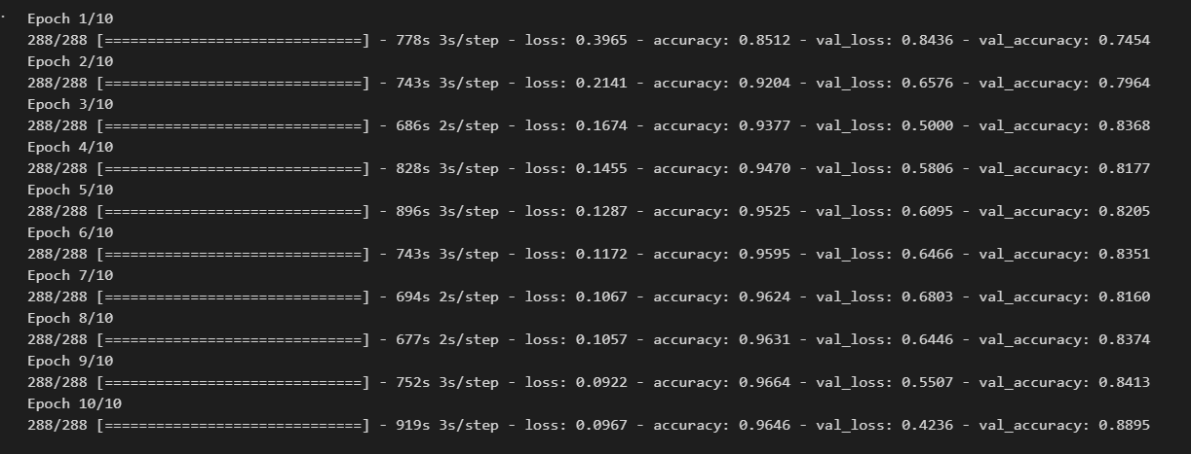
Notes:
After reduce the Dropout(0.2)

Slide 20
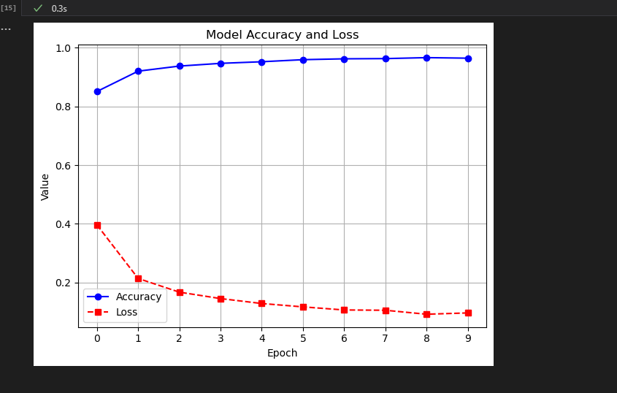

Slide 21
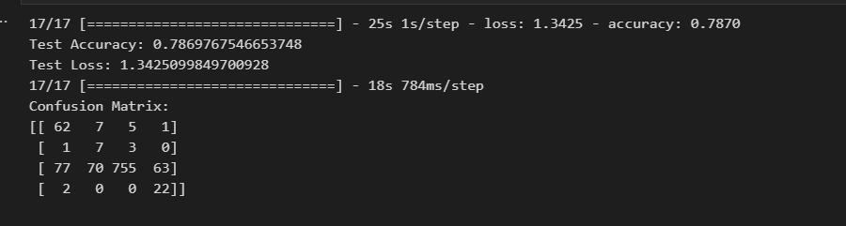

Slide 22
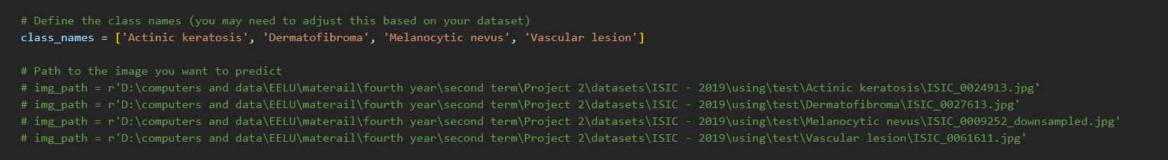

Slide 23
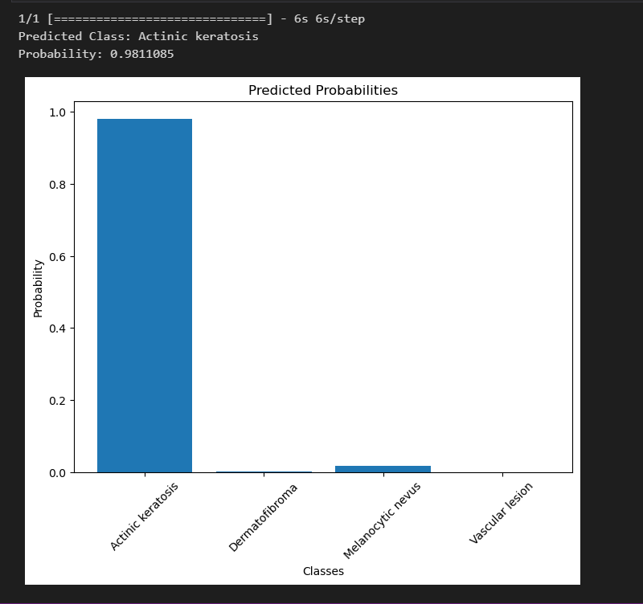

Slide 24
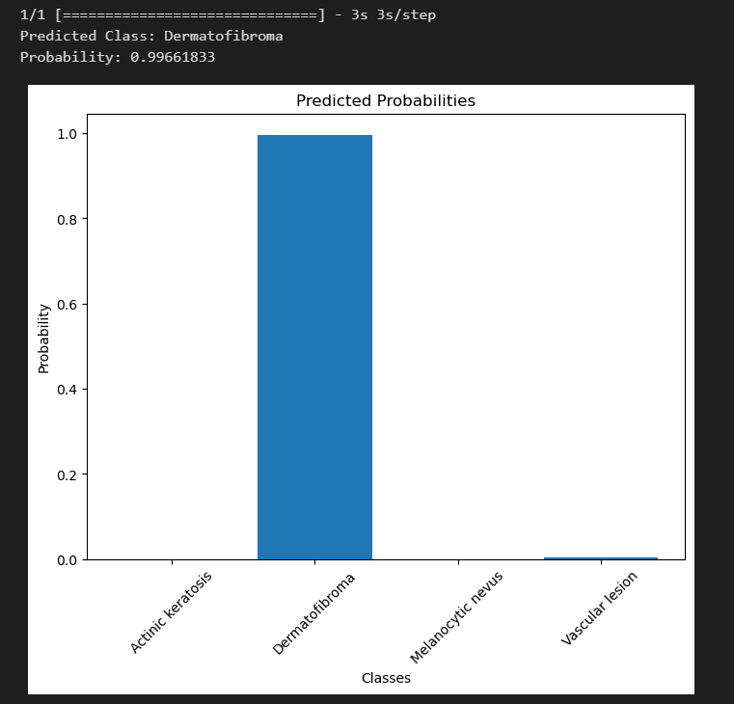

Slide 25
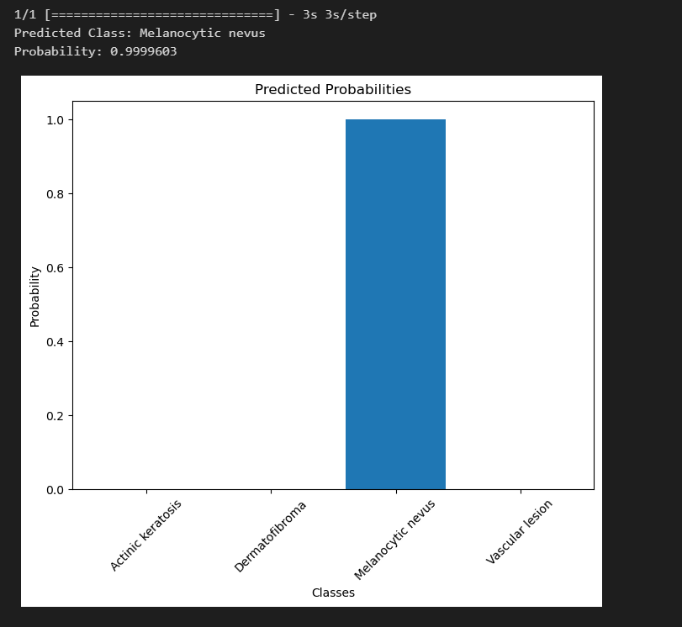

Slide 26
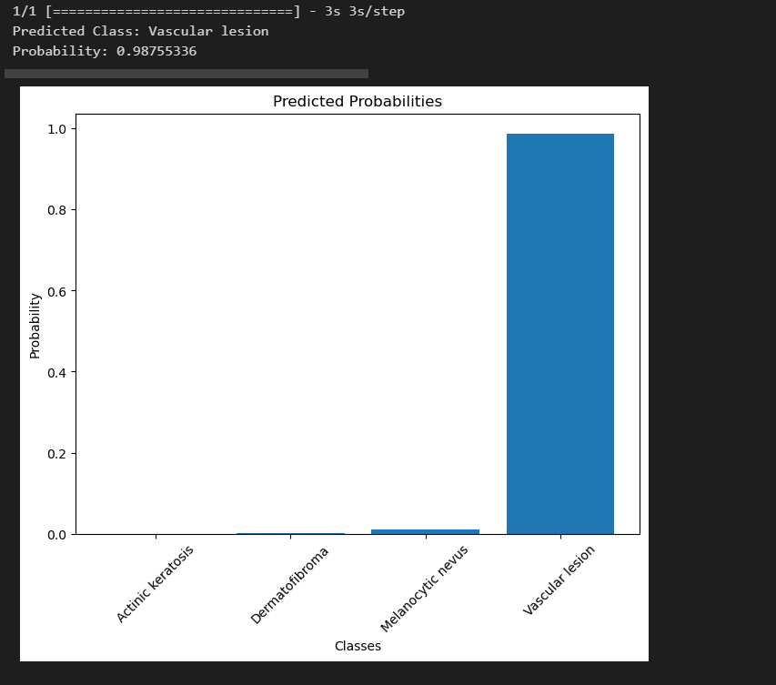

Slide 27
4

Slide 28
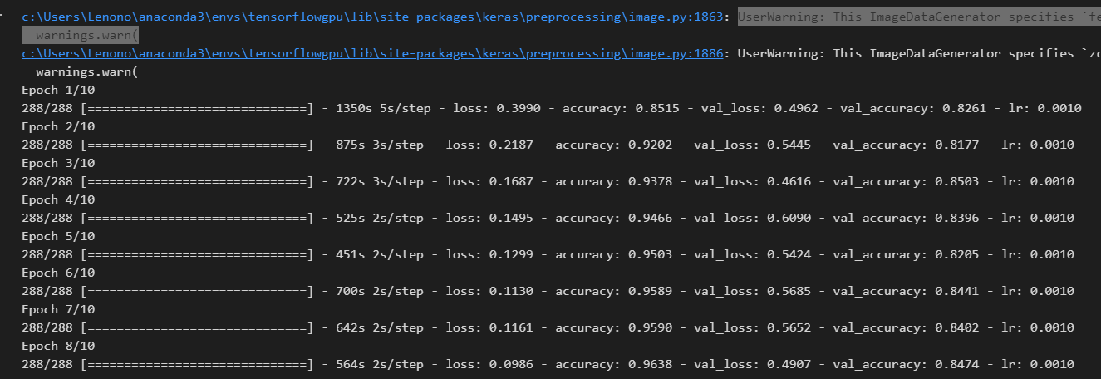
Notes:
Add
reduce_lr = ReduceLROnPlateau(monitor='val_loss', factor=0.1, patience=15, min_lr=0.0001)
early_stop = EarlyStopping(monitor='val_loss', patience=5, restore_best_weights=True)

Slide 29
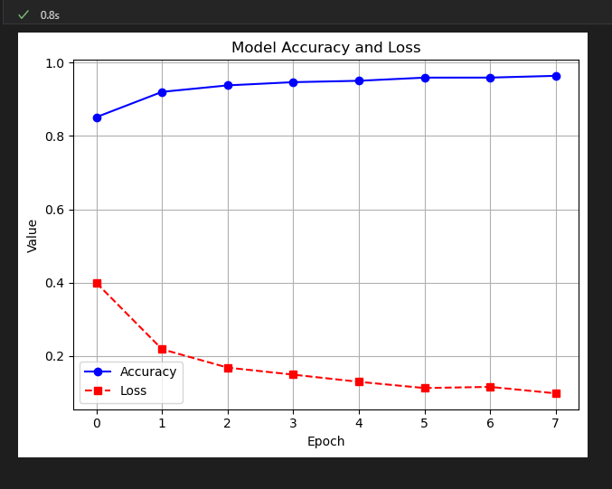

Slide 30
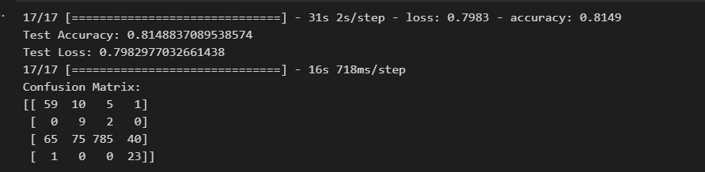

Slide 31
5
Notes:
4/21

Slide 32
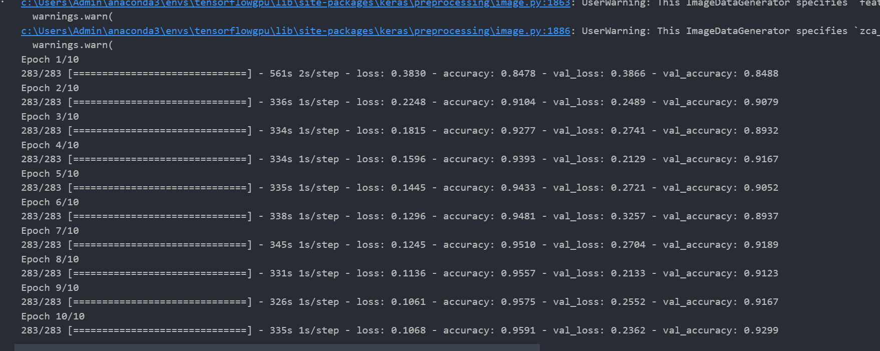
Notes:
Without Add (reduce_lr, early_stop)
Edit data transformation external first (advanced) then use it in code model

Slide 33
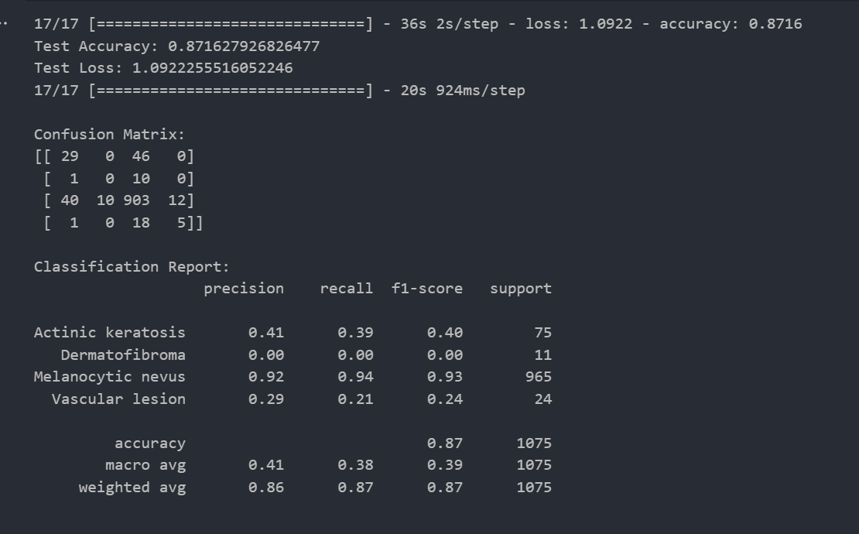

Slide 34
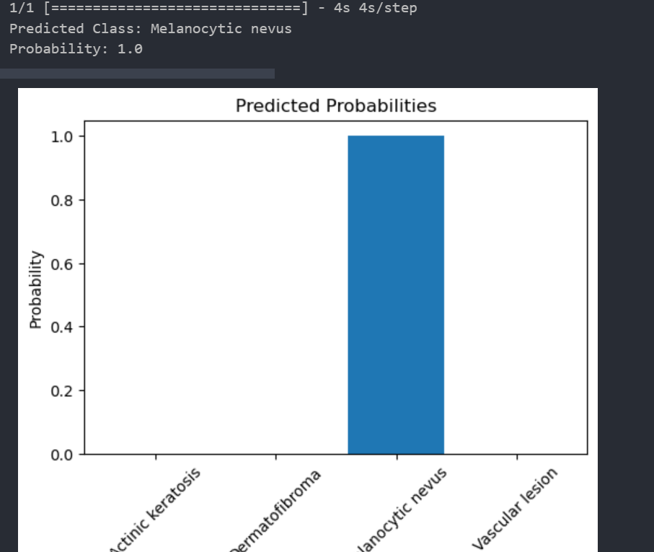
Notes:
The predication failed to predict another disease

Slide 35
6
Notes:
4/21

Slide 36
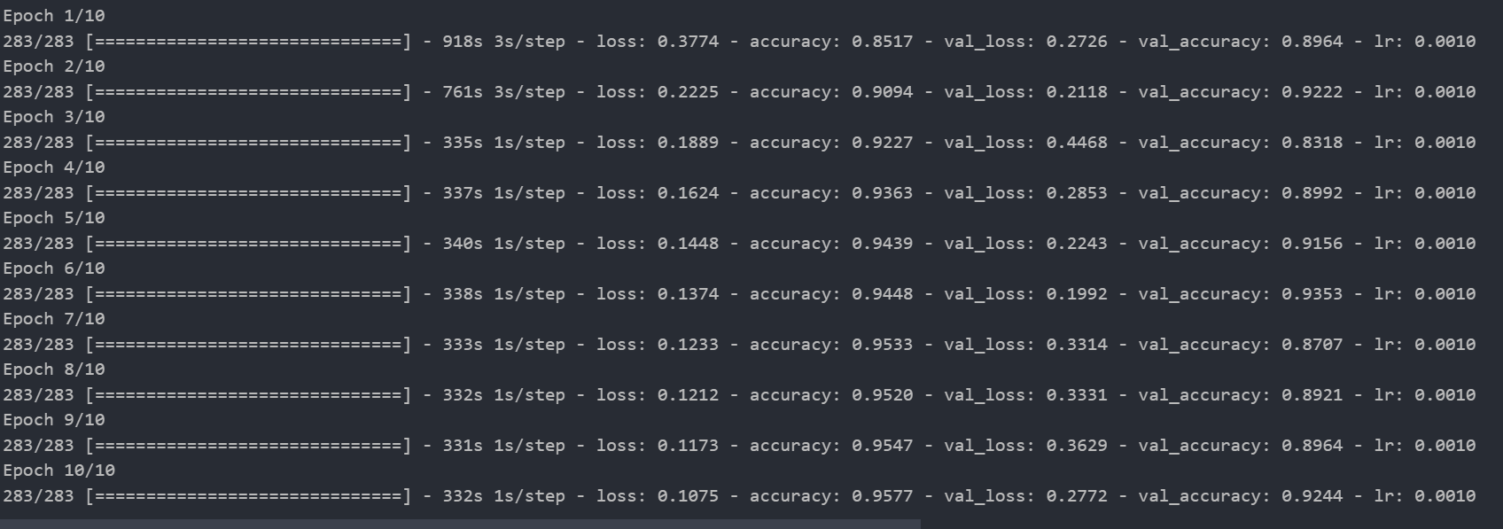
Notes:
With Add (reduce_lr, early_stop) and remove part of preprocessing (for condition)
Edit data transformation external first (advanced) then use it in code model

Slide 37
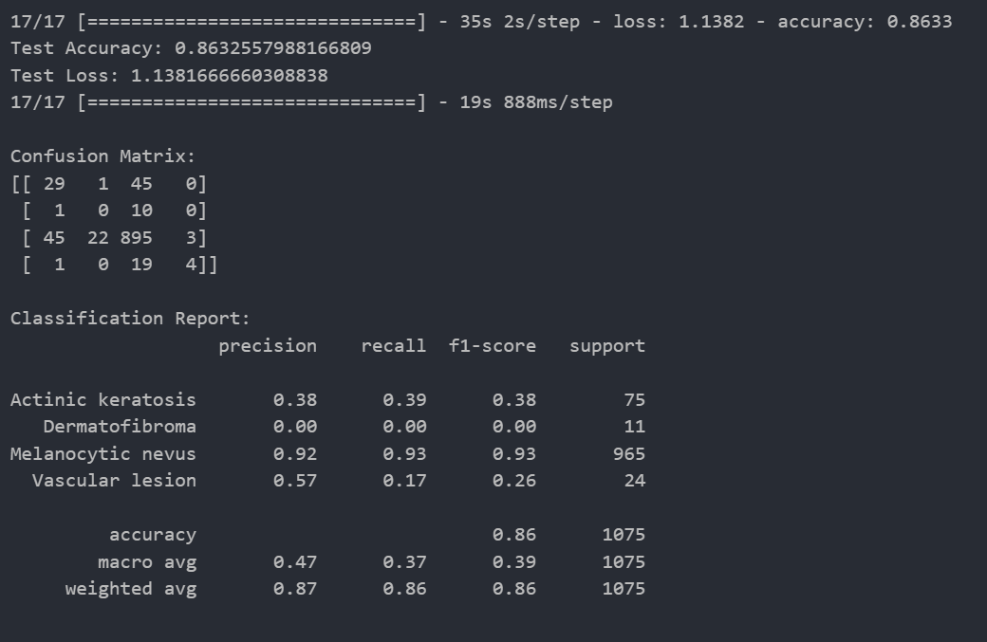

Slide 38
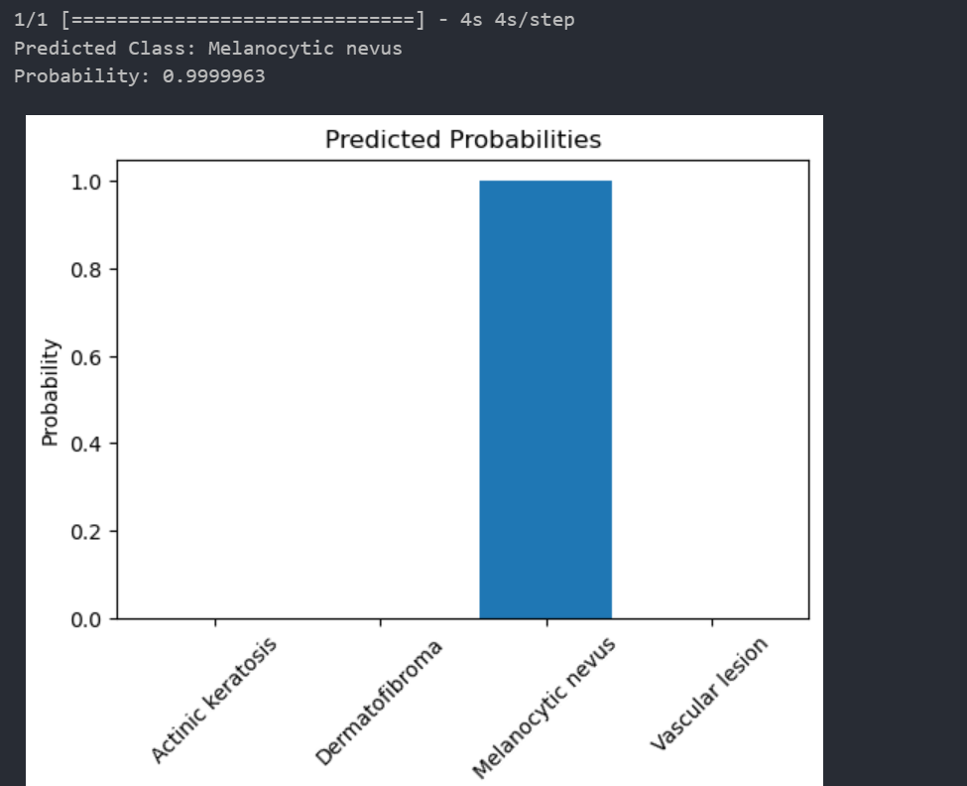
Notes:
The predication still failed to predict another disease (overfitting)

Slide 39
7
Notes:
4/22
Edit (increasedata) with transformation

Slide 40
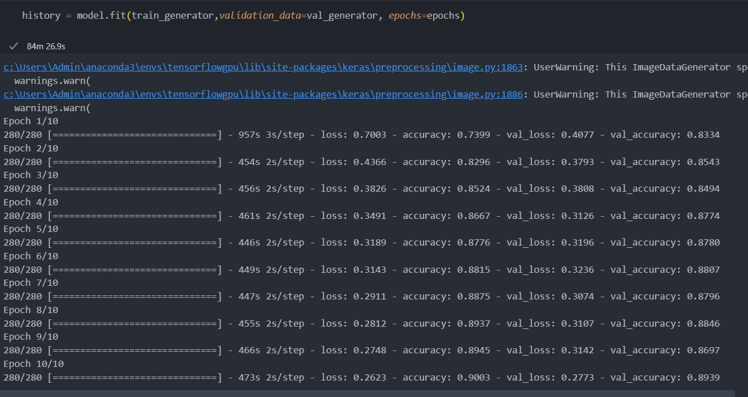
Notes:
Similar try 2 and 4 old code increase data with random transformation
Very good predication need to improve matrix

Slide 41
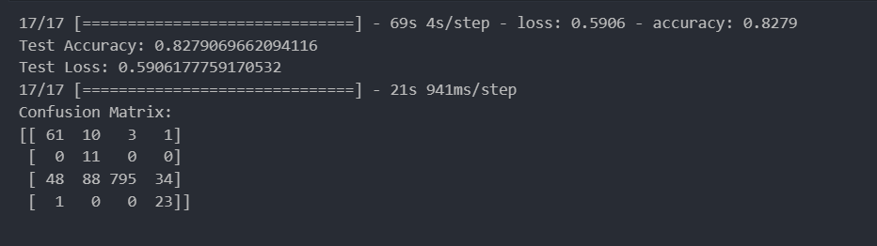

Slide 42
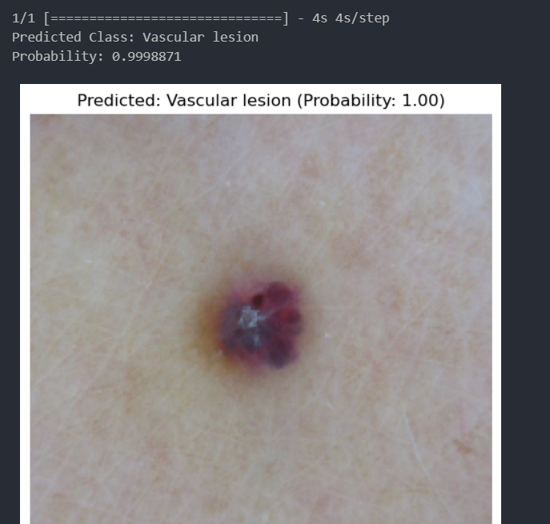

Slide 43
8
Notes:
4/24
With increase data without transformation
Adding Freeze but unfreeze top 30 layers
Using densenet121
8.h5

Slide 44
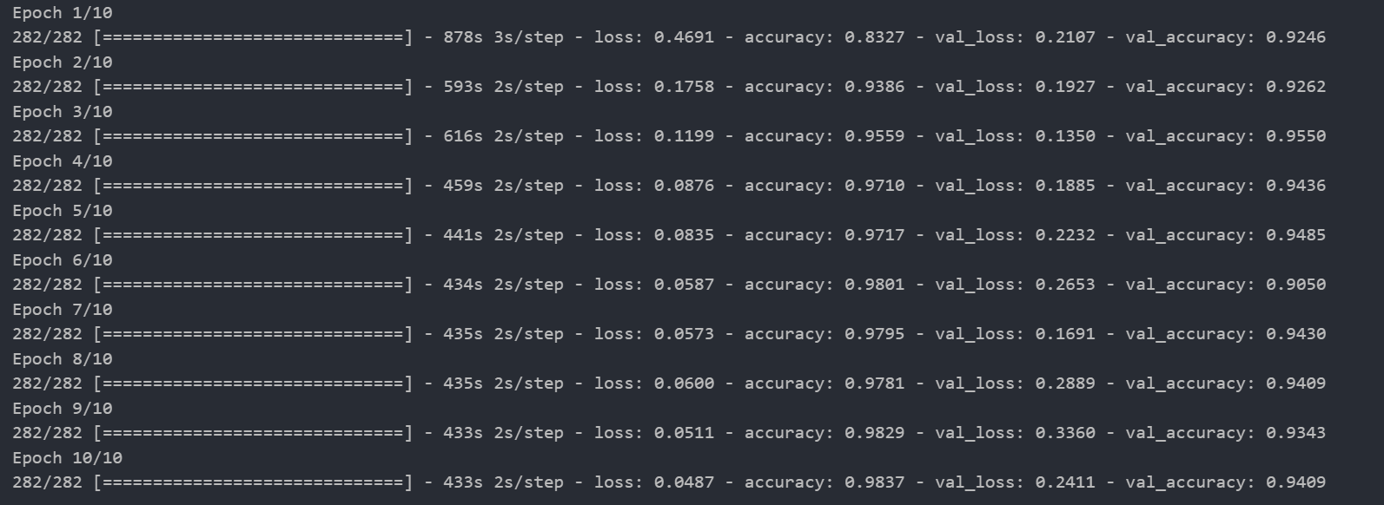

Slide 45
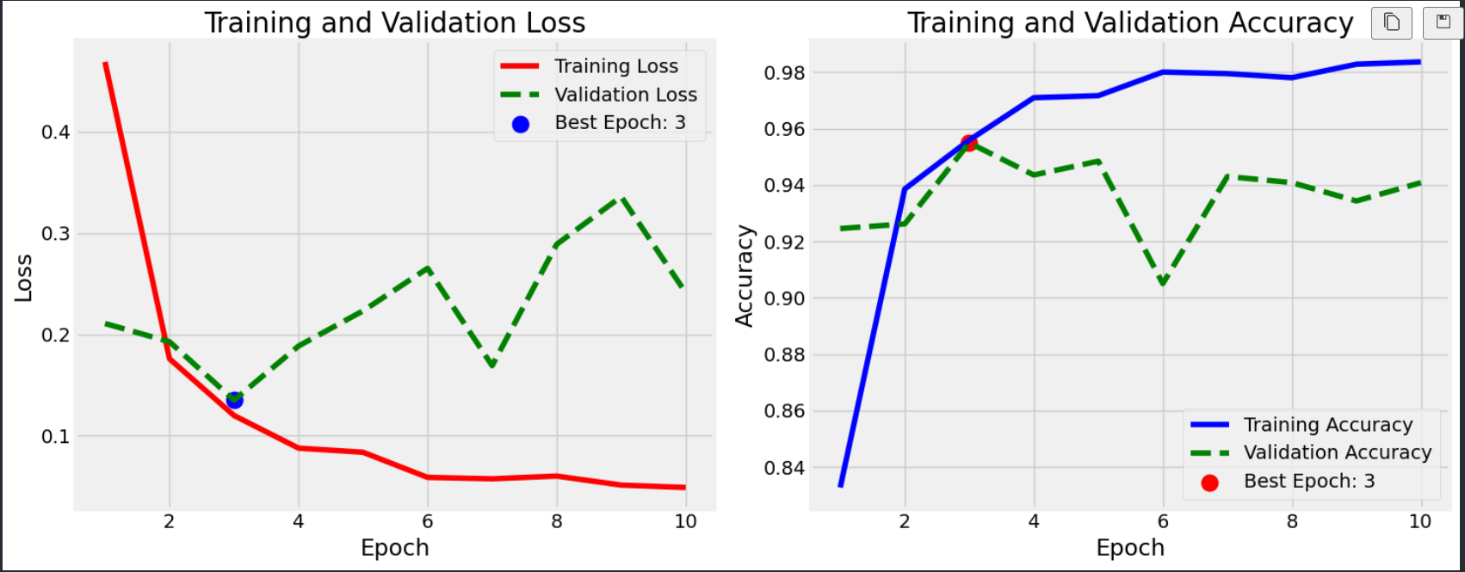

Slide 46
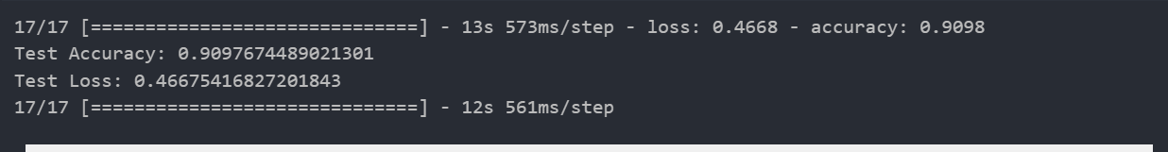

Slide 47
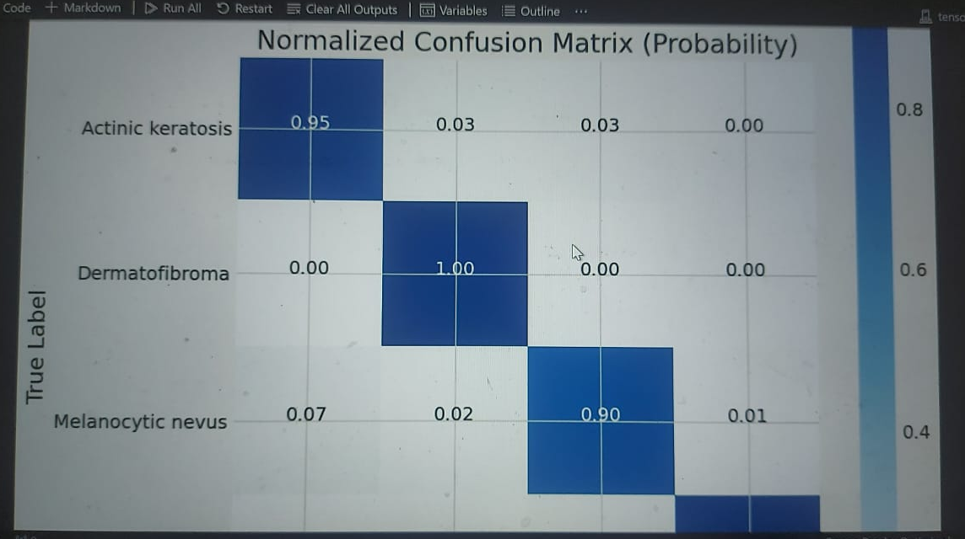

Slide 48
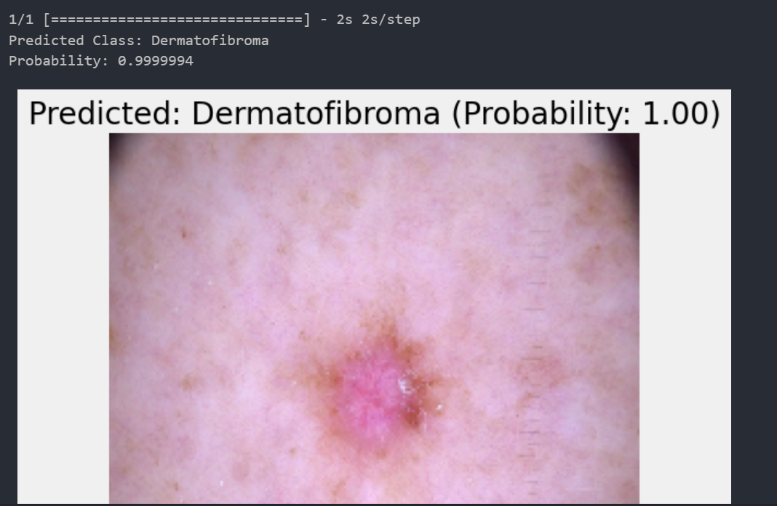

Slide 49
9
Notes:
4/24
With increase data without transformation
Adding Freeze but unfreeze top 40 layers
Using densenet121
(250,250)
9.h5

Slide 50
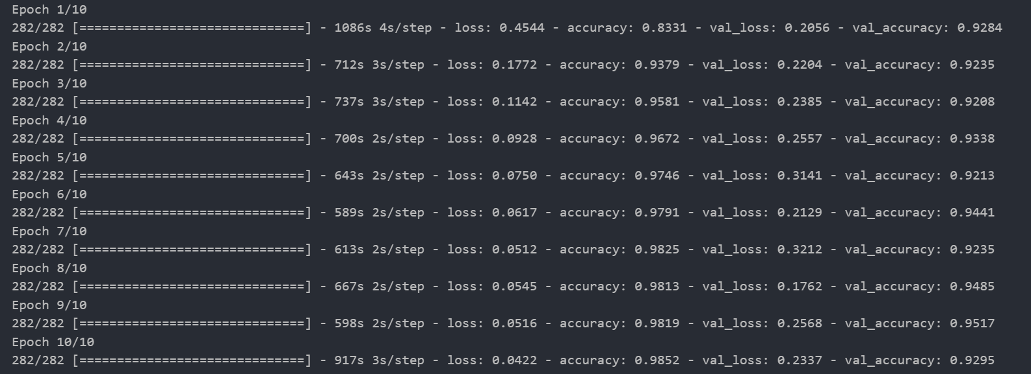

Slide 51
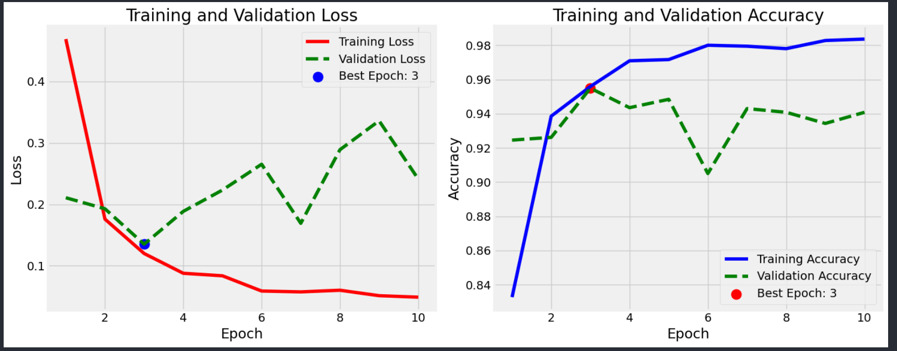

Slide 52
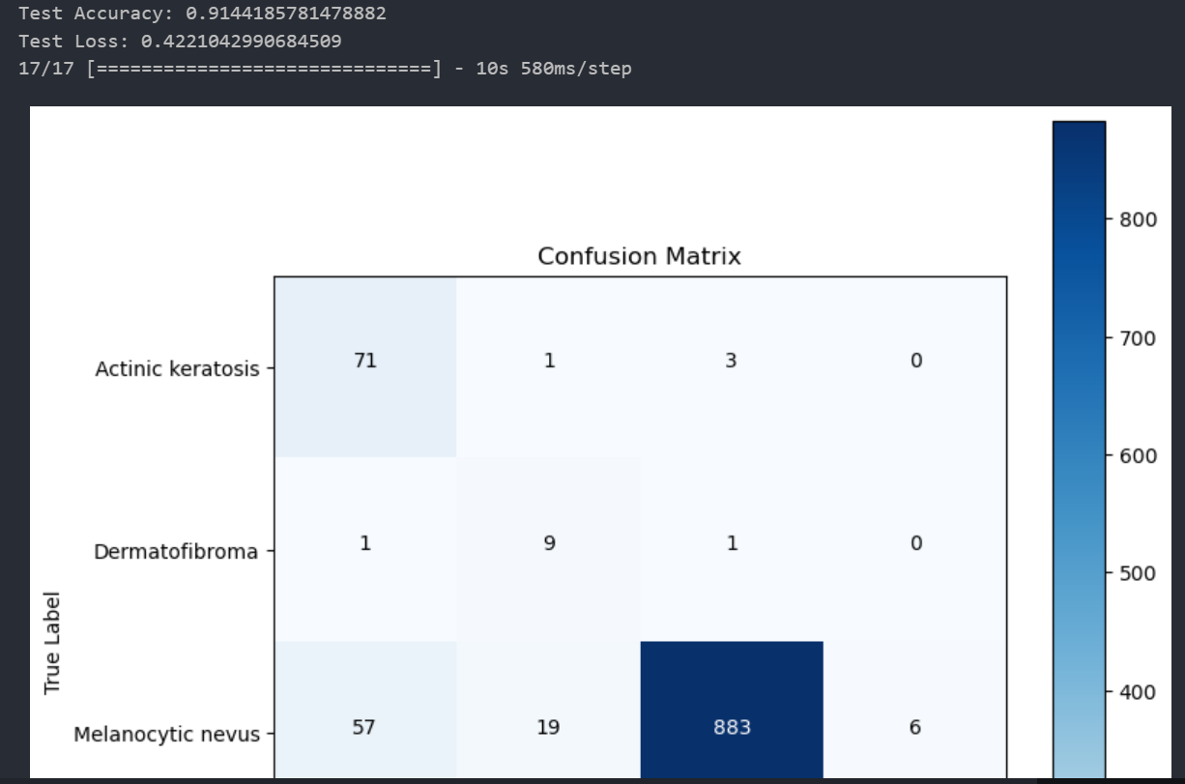

Slide 53
10
Notes:
4/27
With increase data without transformation
Adding Freeze but unfreeze top 30 layers
Using densenet121
(250,250)
10.h5
Drop 0.5/0.5
Epochs 15
Reduce lr only reduce_lr = ReduceLROnPlateau(monitor='val_loss', factor=0.1, patience=15, min_lr=0.0001)

Slide 54
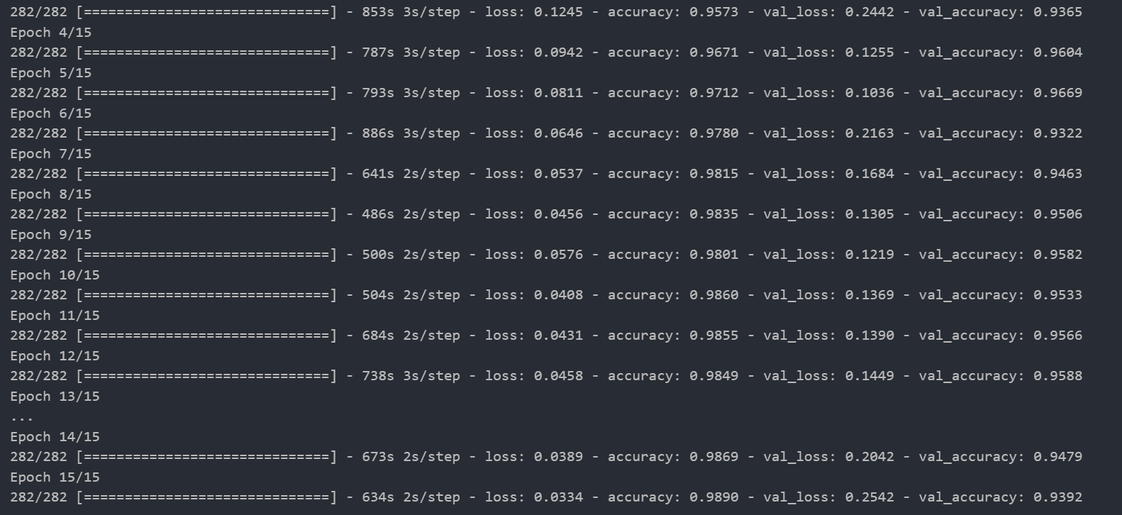

Slide 55
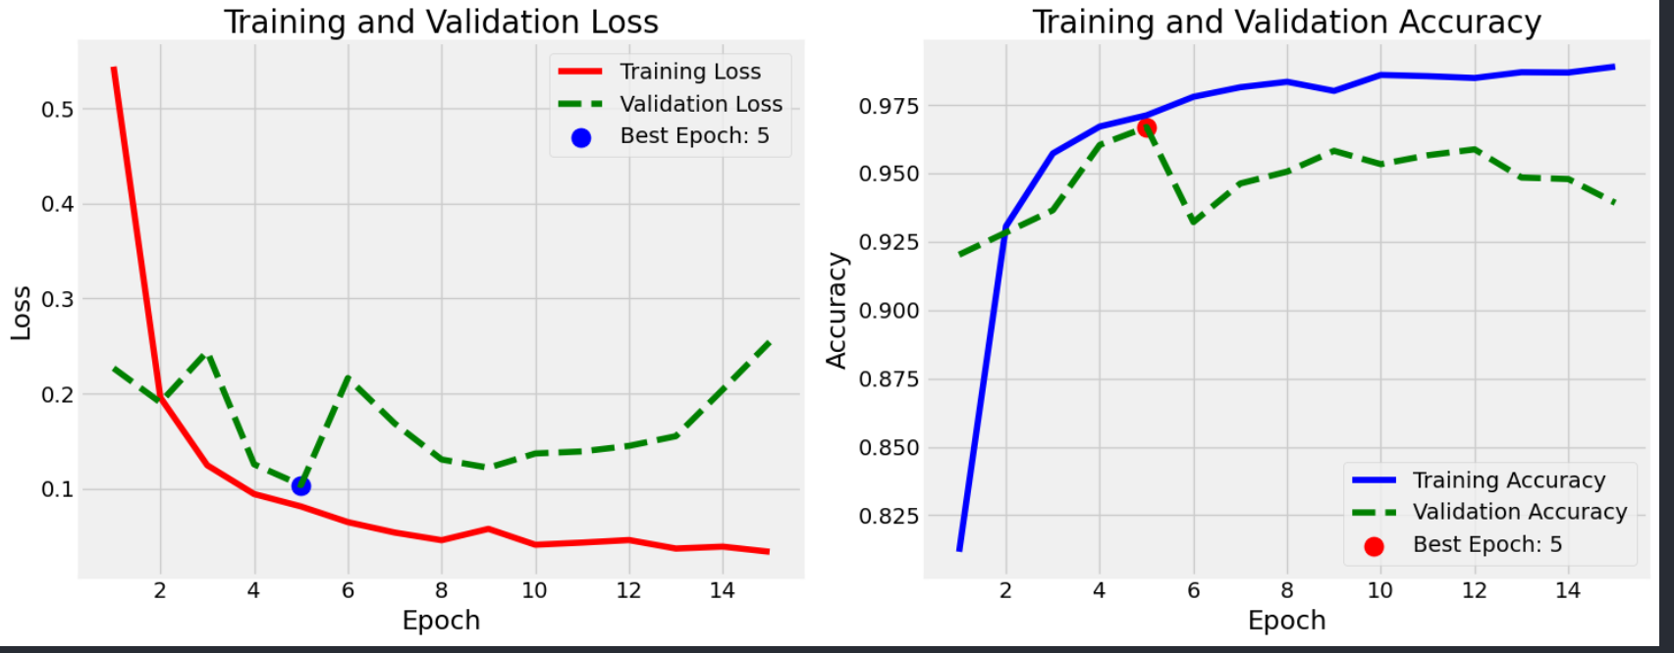

Slide 56
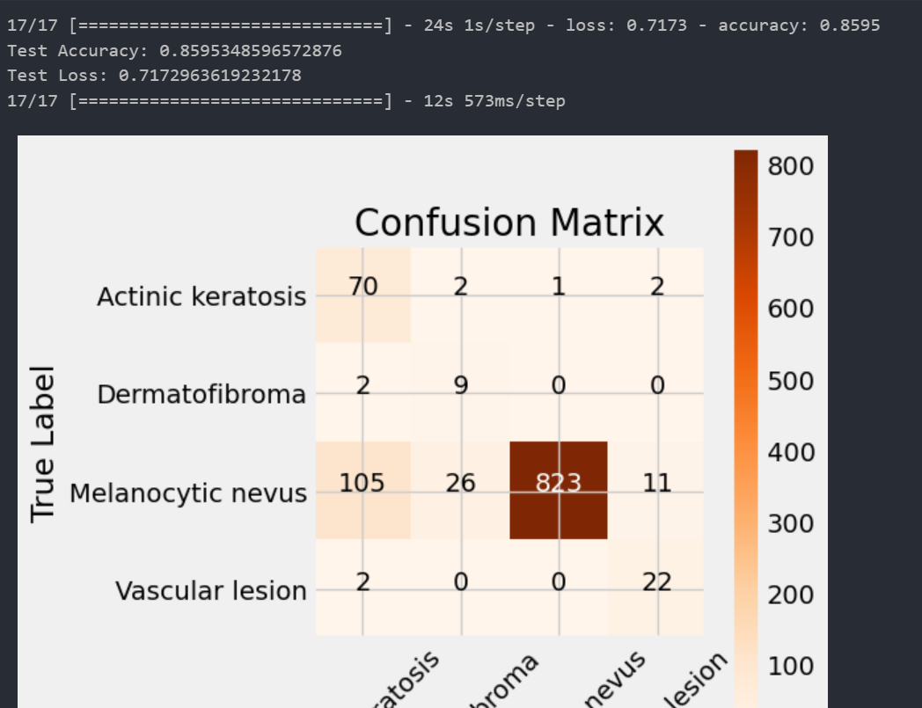

Slide 57
11
Notes:
4/30
With original data and svc
Adding Freeze but unfreeze top 30 layers
Using densenet121
(224,224)
densenet_svc_model.h5
Drop 0.5/0.3
Epochs 100
With dullrazor and adding new arch on the model

Slide 58
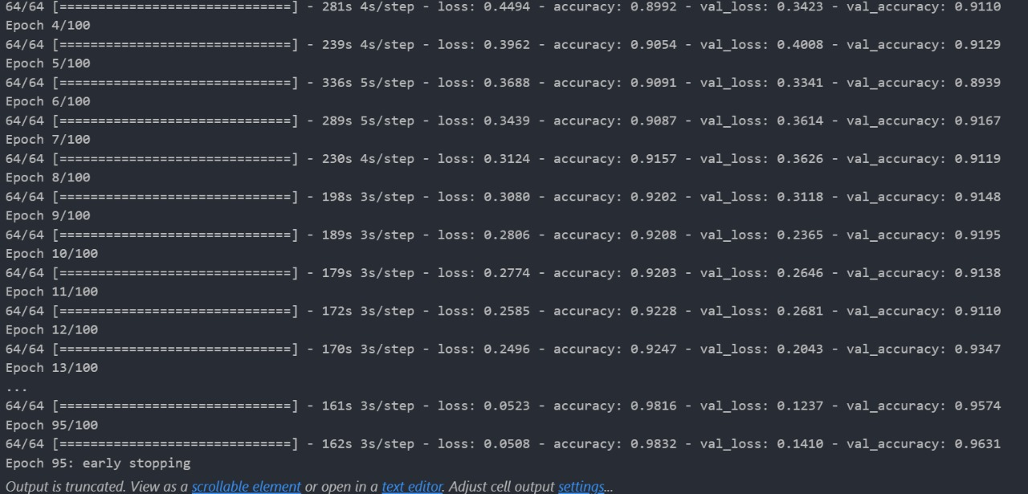

Slide 59
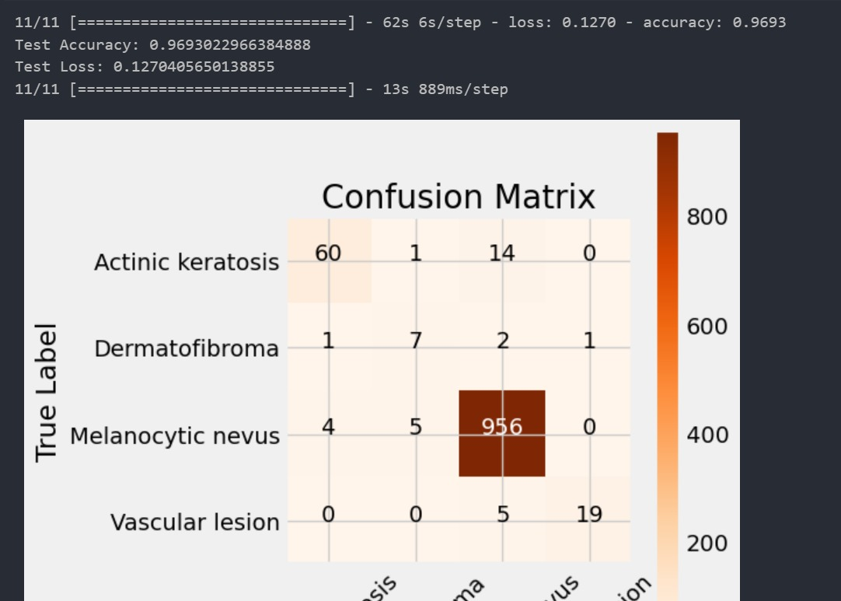

Slide 60
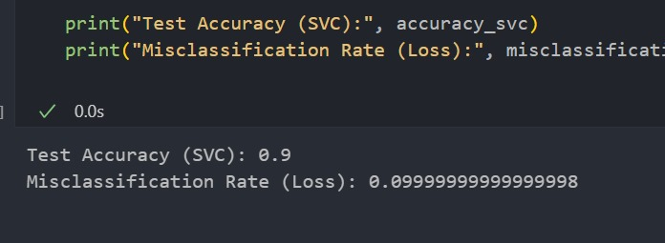

Slide 61
12
Notes:
5/3
With original data and svc
Adding Freeze but unfreeze top 30 layers
Using densenet121
(224,224)
2.h5
Drop 0.5/0.3
Epochs 100
Reduce mel nevs

Slide 62
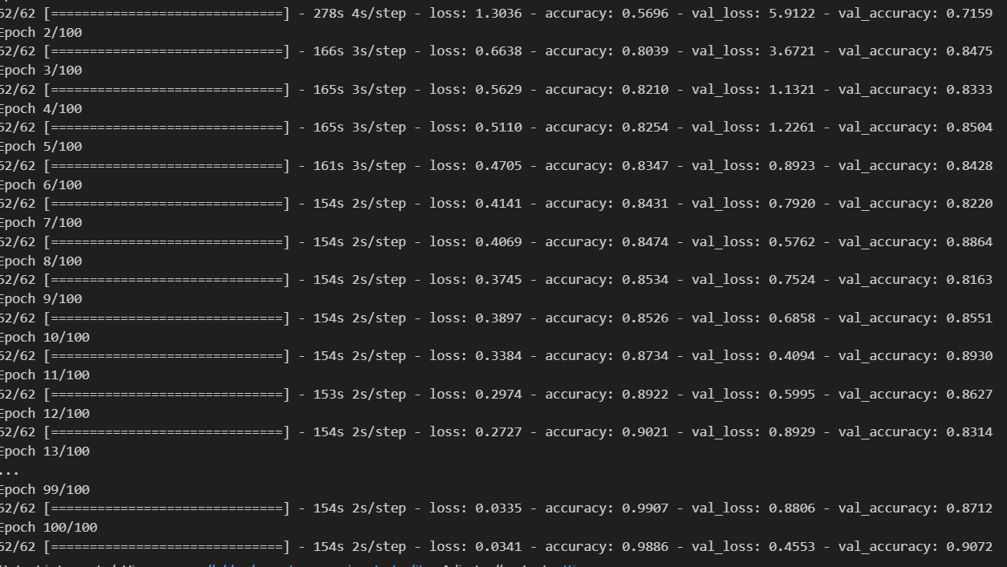

Slide 63


Slide 64


Slide 65


Slide 66
13
Notes:
6/8/2024
With original data and svc
Adding Freeze but unfreeze top 30 layers
Using densenet121
(224,224)
3 disease without nev

Slide 67


Slide 68


